Slide 1
Artist Support Grant Workshop

Slide 2
What are the Artist Support Grants?
The Artist Support Grant was created to provide direct support to individual artists during and following the COVID-19 pandemic. The initiative will fund professional and artists to enhance their skills and abilities to create work or to improve their business operations and capacity to bring their work to new audiences.

Slide 3
Who May Apply?
Individual artists and small, unincorporated groups of collaborating artists are eligible to apply.
Eligible artists include North Carolina residents who have resided in eastern North Carolina for at least 1 year in the following counties: Edgecombe, Greene, Nash, Pitt, Wayne, and Wilson counties. Artists can include musicians, dancers, filmmakers, actors, literary artists, as well as visual artists.
Applicants must be at least 18 years of age and cannot be currently enrolled in a degree or certificate program.
Previous award winners CANNOT reapply consecutive years.

Slide 4
What types of projects are eligible?
Artist Support Grants support professional artists at any stage in their careers to pursue projects that further their artistic development. Grant awards to artists generally range
from $500 to $1,000.
Up to 50 percent of the grant amount
may be used for artist fees!
Projects must be completed between
January 1, 2025 and December 31, 2025.

Slide 5
Fundable Projects
Completion/Presentation of a New Work — Cost of resources necessary to complete or present a significant new work (e.g., purchasing art supplies or equipment (digital may qualify) or space rental
Career Promotion — Projects aimed at advertising artists’ work and/or demonstrating their skill level (e.g., websites, portfolios, audio-visual documentation, and online presentation)
Training — Costs to attend a class or workshop (in-person or virtual) aimed at either enhancing the artist’s skill level or professional development (e.g., a master class or workshop taught by acknowledged authorities in the applicant artist’s medium)
Travel — Costs of transportation, lodging, and food for training, professional conferences, or research as allowed or possible while adhering to social distancing guidelines

Slide 6
Your Application
Just like a job application, a grant application represents you. And like all representations, the image can be flattering—or not. You want to make it easy for the reviewer to see and appreciate your work and your project, so the first rules in presenting yourself are:
Be professional.
Convey that you are a serious artist and have a feasible project.
Type your application and résumé, provide all the requested materials in the order and manner specified
Proofread everything before you send it in.
Don’t get in your own way.
Let your supplemental material show your artistic nature.
Expressive gestures that aren’t to the point are at best distracting
You wouldn’t submit anything like that with a job application, so don’t treat this process with any less respect.

Slide 7
Meeting the Requirements
Each region in the Artist Support Grant program has its own application and its own list of required forms and materials, but most request a:
Narrative
Project budget
Resume or bio
Work samples
Letters of recommendation (optional)

Slide 8
The Narrative
You will need to describe your project and explain how the accomplishment of this project will further your development and/or career goals as an artist.
Be Feasible.
Be Logical.
Use simple, declarative sentences, active voice—and get to the point.
Who, what, when, where, why, and how.
This is not an artist statement.
Get a non-arts friend or acquaintance to read your application.

Slide 9
Budget
Provide detail. As a general rule, more detail is better. Which of the following gives you more confidence that the artist has thought through the project expenses?
-- Equipment (List Type) $600
-- Workshop Cost $250
-- Travel Costs $125
-- Lodging (4 nights @ $85) $340
-- Supplies (list and identify) $200
--Total $1515
Admittedly, some grantors will want you to round your amounts up or down so that the budgets are easier to take in quickly, but if you can show that you’re not just picking numbers out of thin air, you will make a stronger case for yourself.

Slide 10
Budget
Provide supporting documentation. Most of us have a general idea of what a hotel room should (and shouldn’t) cost, but fewer know what a new lathe or bandsaw runs. Web creation costs and graphic design fees can vary widely. So, it’s not a bad idea to get an estimate from the provider to support the numbers you’re putting in your application.
Show your own financial contribution and other sources of income. No consortium will require that you spend your own money; nevertheless, if you can show you are investing your own funds (over and above your time) to accomplish a project, your commitment to it will be obvious.

Slide 11
Resume and Bios
Résumés are required but are generally reviewed as supporting material to the work samples and narrative.
Make it an Artist resume.
Abbreviate It.
Limited Experience as an artist? Lead with what you have on your résumé and condense the rest to the very broadest strokes. Use this situation to make the case that the grant is especially important as a way to take a meaningful step forward in your artistic career.

Slide 12
Work Samples
Even though this is a project grant, your project will not be funded if your work samples are weak. The first stage in every process is an artistic evaluation, so you need to pay attention to what you choose to submit.
With work samples it’s a matter of avoiding mistakes first.
If you’re a writer make sure there are no typos in your manuscript and that it’s formatted in a readable manner (e.g., adequate margins and line spacing)
If you’re a visual artist avoid out-of-focus, poorly cropped, or cluttered images.
For everyone – Upload your files

Slide 13
Work Samples
Choose samples that you consider to be:
Strong and recent representations of the quality of your work. If you’re submitting more than one sample, it’s generally best to stay in genre. Coherence helps anchor your work in the panelist’s mind and avoid unflattering comparisons if they sense unevenness.
In keeping with the project you have proposed. Your pastels may be lovely but they don’t say much about your ability to do large-scale fresco painting. If it’s all you’ve got then go with it, but understand that the panel may have reservations that you will need to address.

Slide 14
Work Samples Descriptions & Labeling
It is a good idea to also attach a work-sample description page, numbered in the same order as the works on the sample.
Visual artists: title, date of completion, medium, dimensions
Composers and songwriters: title, date of completion, running time of selected segment, and instrumentation
Choreographers: title, date of completion, running time of selected segment, where and when the performance took place, and the performers
Filmmakers: title, date of completion, running time, original format, your role and the role of other key people in the production, relevant technical considerations, and a brief synopsis of complete work
Writers: title, genre, and a brief synopsis of the work as a whole if needed
Performers: instrument or role played, name of production, when and where performance took place, and name of ensemble or company

Slide 15
VISUAL ART WORK SAMPLES:
Jpeg format only at highest Jpeg setting
Min. 72 dpi with largest size at 12” or less
Save each entry as separate file, no power point submissions
Title each file with artist’s name and number
Submit an accompanying work sample description sheet

Slide 16
MUSIC / STORYTELLING
Upload file or create a .docx file with links
Try to eliminate background noise
Do not introduce or interpret your work
Label you files

Slide 17
PERFORMING
Upload file or .docx file with links
Exclude any extraneous information

Slide 18
LITERARY
Type your entry
Use a standard font, 12 pt
Upload .docx or .pdf file

Slide 19
Some Examples of What Not To Do if you are a Visual Artist

Slide 20
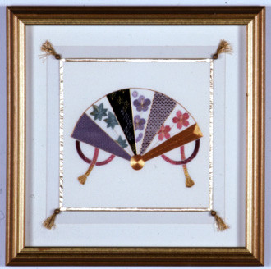

Slide 21
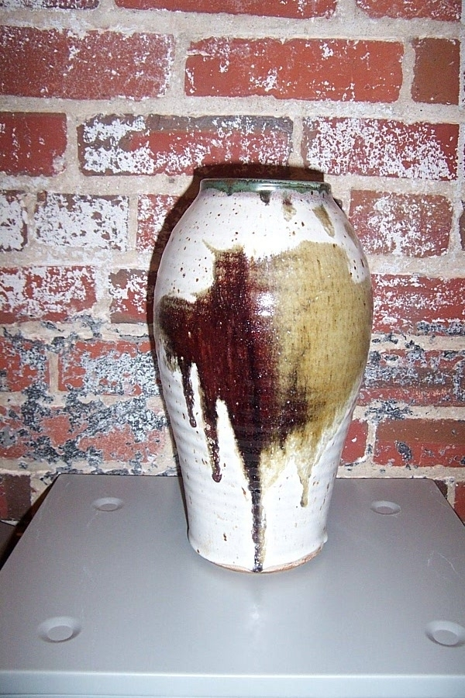

Slide 22
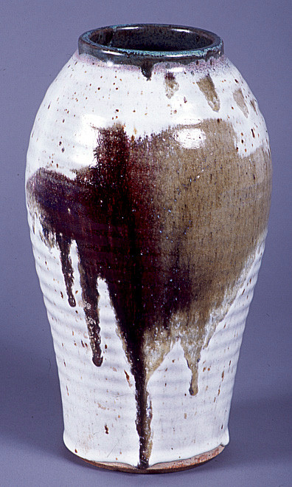
YES!!!

Slide 23
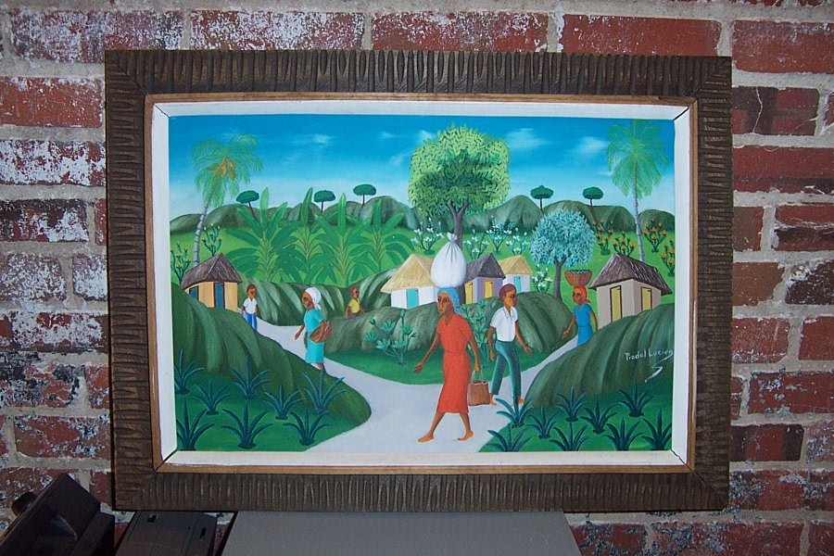

Slide 24
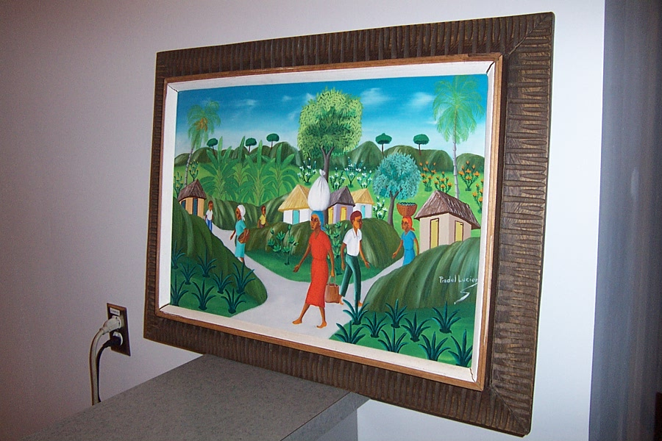

Slide 25
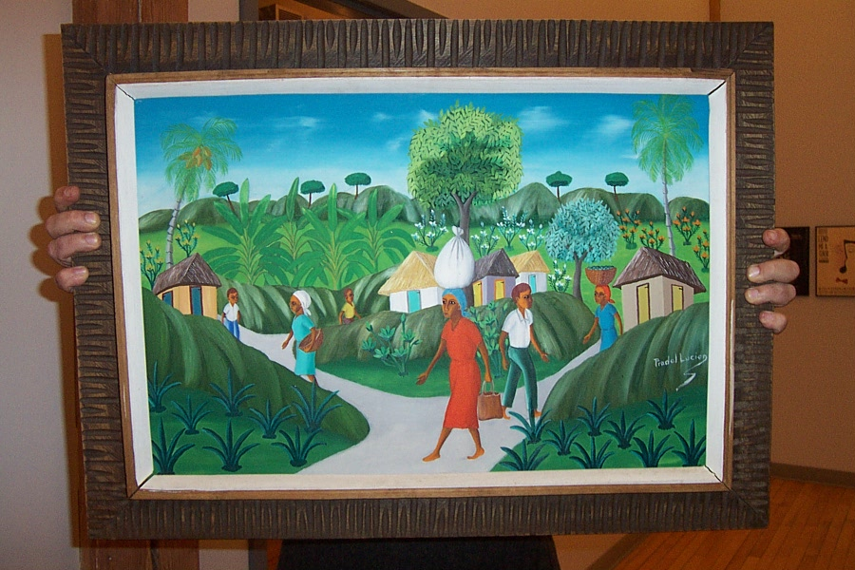

Slide 26
Letters of Recommendation
As a general rule, unless you have known, qualified references who can speak specifically and enthusiastically about your abilities as an artist, their value to you and your application is only that they not damage your credibility. Consider the following as you choose your references:
First-hand knowledge of your work as an artist
Professional credentials (this is not a personal recommendation)
How recent is the reference’s encounter with your work
Ask them!!
You want to tell your references about the project you’re planning and send them a résumé. It’s better to know ahead of time than to find out afterwards you asked the wrong person.

Slide 27
Best Advice
Make all submissions and packets look like they came from a professional ARTIST
Double check EVERYTHING!
Required materials
Digital materials
Due dates

Slide 28
Finally…
Meet the Deadline!
October 5, 2024 by 11:59pm
Online Applications Only
https://www.pittcountyarts.org/artists/grants/
artist-support-grants

Slide 29
Artist Support Grant Workshop

